Slide 1
Maker’s university – by intel’s makers community Control and communication over the air
Gil Tal.
Feb 2025

Slide 3
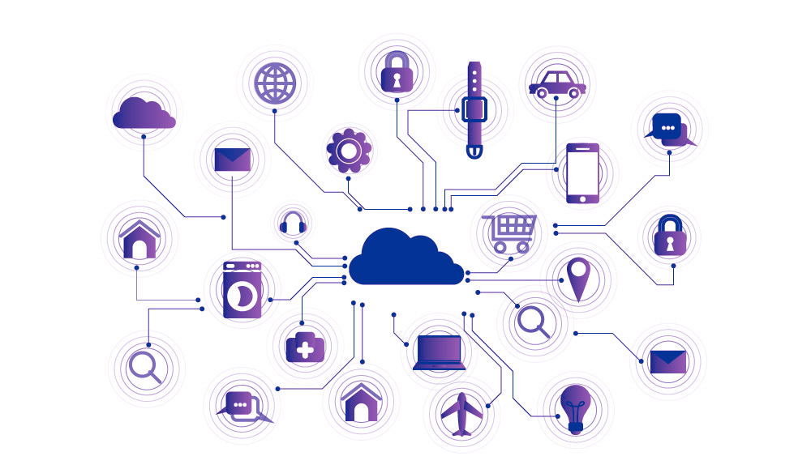
IOT
The Internet of things (IoT) describes the network of physical objects - a.k.a. "things“ - that are embedded with sensors, software, and other technologies for the purpose of connecting and exchanging data with other devices and systems over the Internet
Used for:
Smart Homes
Elder care
Agriculture
Environmental monitoring
And more ….

Slide 4
Control and communication over the air:
Near me (up to 100m)
Bluetooth
Wi-Fi
Farer – 2-10 Km
LoRa
All over the world (Ethernet)
Firebase (By Google)
3\4 G modems

Slide 5
Agenda:
ESP-Now protocol (Direct WiFi)
Bluetooth (BLE)
OTA (Over The Air update)
LoRa
Firebase

Slide 6

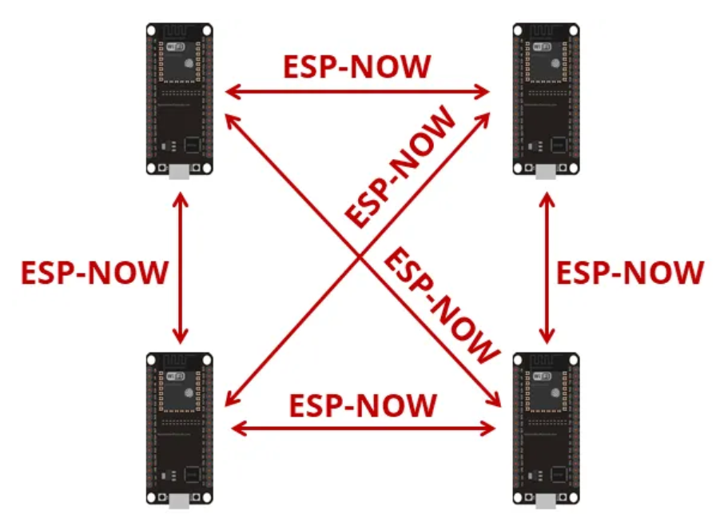
Protocol developed by Espressif
Enables multiple devices to communicate directly over WiFi radio
No need for access point!
Low-power 2.4GHz wireless connectivity
Encrypted and unencrypted unicast communication
Up to 250-byte payload can be carried
10 encrypted peers at the most (STA mode), 6 for SoftAP or STA + SoftAP

Slide 7

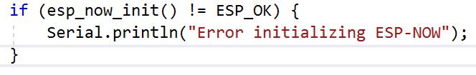
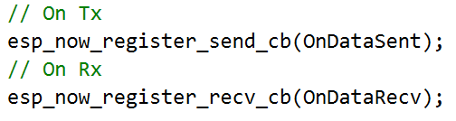

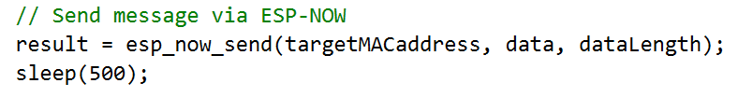
ESP-now
Works with MAC address
Need to know our MAC and the Peer’s
Initialize the protocol
Register callback functions for send and receive
Register peers
Upon sending the send function will be called:
With status
With the MAC of the targeted peer
Upon receiving the receive function will be called:
With the MAC of the sender
With the received data

Slide 8
ESP-NOW code flow:
ESP-NOW_AUX driver (in the GIT code)
#include <WiFi.h>
#include "EspNowAux.h"
#define MAC_LEN 6
Void loop()
{
String deviceMAC;
deviceMAC = WiFi.macAddress();
if (!ESP_NOW_CLASS.init())
{
DEBUG_MSG("ESPnow failed\n");
generalErrorStatus = true;
}
ESP_NOW_CLASS.on(true);
ESP_NOW_CLASS.sendDataToPeer(peerMACaddress, "ping", 10);
if (ESP_NOW_CLASS.getNumberOfAvailableMessages() > 0)
{
ESP_NOW_CLASS.popMessage(&dongleMessage, peerMACaddress /* or null for any message */);
}
}

Slide 9
BLE
Power-efficient wireless communication technology designed for short-range data exchange
Short-Range Communication – Typically 10–50 meters range
Optimized for Small Data Transfers – Ideal for sensors and beacons
Supports Peripheral & Central Roles – Devices can act as advertisers (peripheral) or scanners (central)
Uses GATT (Generic Attribute Profile) – For structured communication between devices
Our ESP32 supports BLE (ESP32 and ESP32-S3, the S2 variant does not support BLE)

Slide 10
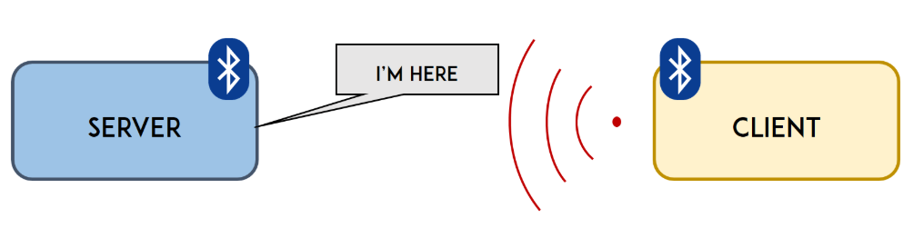
ESP32’s BLE options
Standard ESP32 supports BLE4
ESP32-S3 supports BLE5
Standard BLE stack for communicating with phones, and any other devices, as a BLE Server or Client
UART over BLE (We will discover in our BLE capable laptop a UART device as a BLE device)
Great link to deep dive into ESP32 with BLE:
https://randomnerdtutorials.com/esp32-bluetooth-low-energy-ble-arduino-ide/
In code examples refer to BLE UART code

Slide 11
OTA - FW update to our IOT device
IOT device without OTA (Over The Air Update) is probably not an IOT device ☺
We have few options to update the software of our ESP32
Through WEB page running on ESP32’s WEB server (Elegant OTA)
Just surf to 192.168.4.1/update (Our ESP32’s IP or Direct web name using mDNS: MeMake.local/update)
From a file residing on a SD card:
Init the SD just like in our examples
updateFromSD(SD, "/NewSketch.bin")

Slide 12
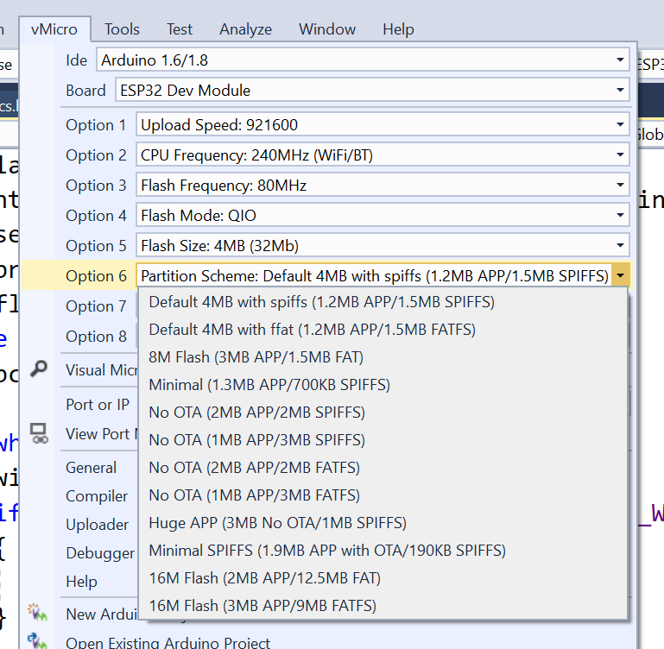
ESP32’s Partition table
To enable safe OTA an IOT device must have two SW partitions on its flash memory
ESP32 gives us the flexibility to control it’s partition table

Slide 13
LoRa
LoRa (Long Range) is a low-power, long-range wireless communication technology designed for IoT (Internet of Things) applications.
Operates in the sub-GHz ISM bands (e.g., 433 MHz, 868 MHz, 915 MHz)
Long Range – Up to 10-15 km in rural areas, 2-5 km in urban areas
Peer to peer communication using 64K channels
Low Power Consumption – Ideal for battery-operated IoT devices
Low Data Rate – Optimized for small, infrequent data packets (~8KB\Sec)
High Interference Resistance – Uses spread spectrum modulation for robust communication
Supports Star & Mesh Topologies – Works with LoRa WAN for large-scale networks

Slide 14
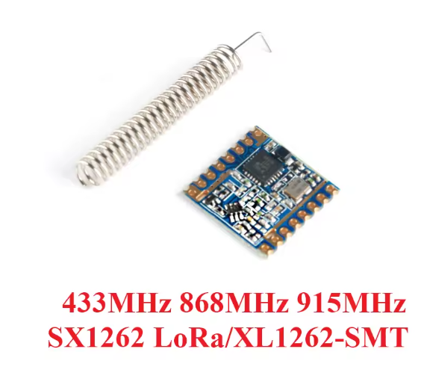
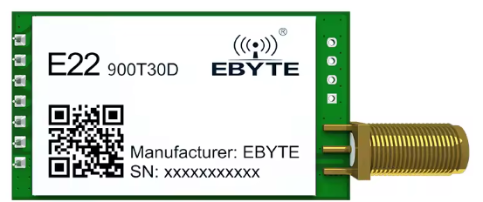
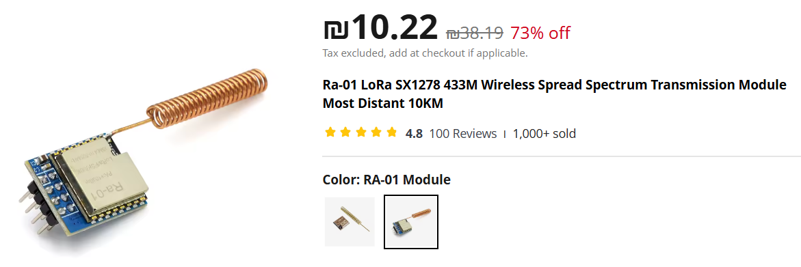
LoRa devices:
Interface to ESP32 via SPI

Slide 15
LoRa code with ESP32: (Transmitter)
#include <SPI.h>
#include <LoRa.h>
// Define LoRa module pins
#define SS 18
#define RST 14
#define DIO0 26
#define SPI_SCK 18
#define SPI_MISO 19
#define SPI_MOSI 23
void setup() {
Serial.begin(115200);
while (!Serial);
// Setup LoRa module
Serial.println("Starting LoRa...");
LoRa.setPins(SS, RST, DIO0);
if (!LoRa.begin(915E6, SPI_MISO, SPI_MOSI, SPI_SCK)) { // Set frequency (868E6 for EU, 915E6 for US)
Serial.println("LoRa init failed!");
while (1);
}
Serial.println("LoRa Initialized.");
}
void loop() {
Serial.println("Sending packet...");
LoRa.beginPacket();
LoRa.print("Hello ESP32 LoRa!");
LoRa.endPacket();
delay(2000); // Send every 2 seconds
}

Slide 16
LoRa code with ESP32: (Receiver)
#include <SPI.h>
#include <LoRa.h>
#define SS 18
#define RST 14
#define DIO0 26
void setup() {
Serial.begin(115200);
LoRa.setPins(SS, RST, DIO0);
if (!LoRa.begin(915E6)) {
Serial.println("LoRa initialization failed!");
while (1);
}
Serial.println("LoRa Receiver Ready.");
}
void loop() {
int packetSize = LoRa.parsePacket();
if (packetSize) {
Serial.print("Received Data: ");
while (LoRa.available()) {
Serial.print((char)LoRa.read());
}
Serial.println();
}
}

Slide 17
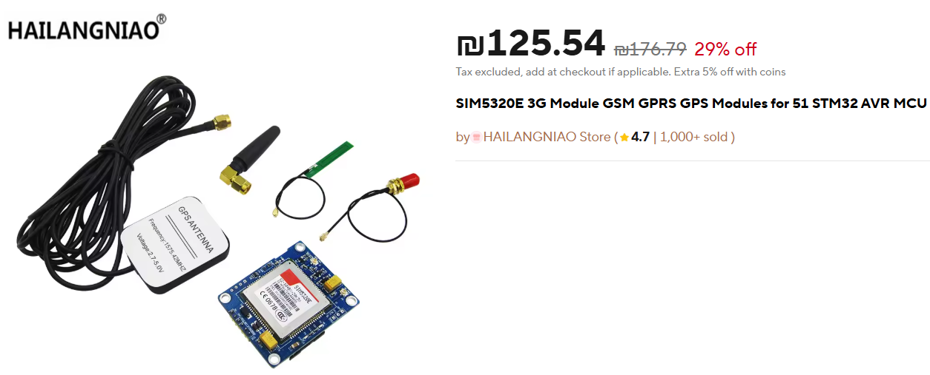
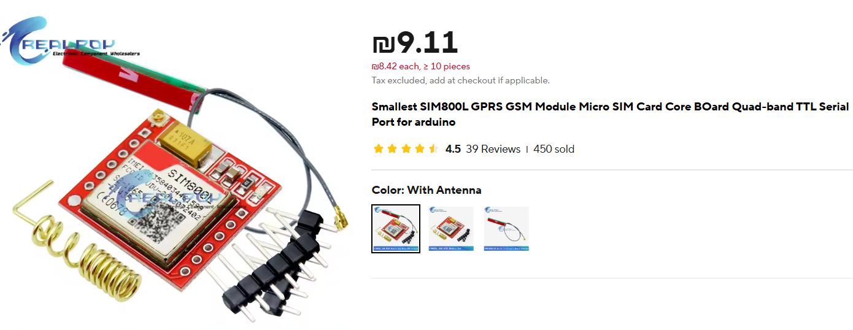
2G\3G modems
Interface uses UART
Communication with module via AT protocol
Can generate calls, receive calls, send and receive SMS
Requires an active SIM

Slide 18
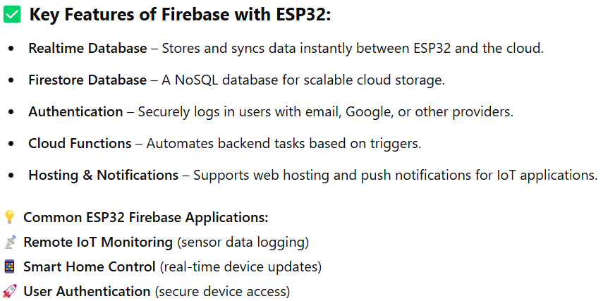
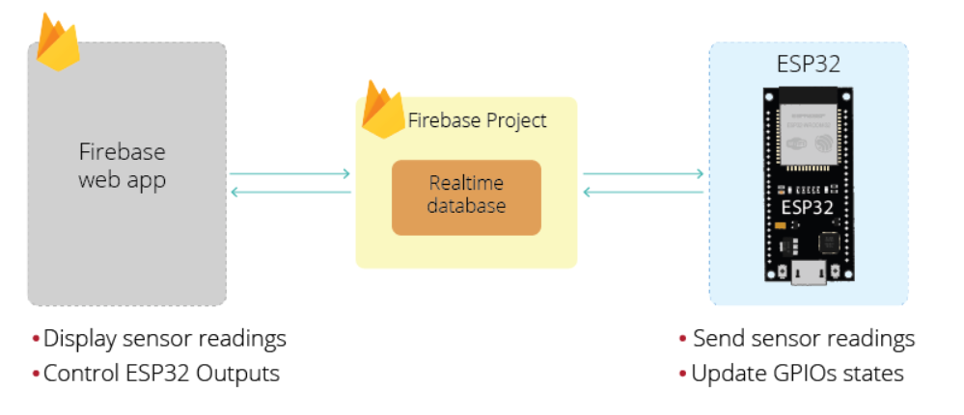
Google Firebase:
Cloud-based platform that provides real-time database, authentication, cloud storage, and hosting services for IoT applications. When used with the ESP32, it enables seamless data storage, retrieval, and remote control via the internet

